Slide 1


SOFTWARE Design & Analysis (Week-13)
Usama Musharaf
MS-CS (Software Engineering)
Lecturer (Department of Computer Science)
FAST-NUCES Peshawar

Slide 2
Agenda of Week # 13
Event Driven Programming
Java Database Connectivity
SOLID Principles

Slide 3
One of the most important aspects of most applications is the ability to respond to events that are generated by the various components of the application.
GUI generates event when the user interacts with GUI e.g
Clicking a Button
Moving the Mouse
Closing Window etc.

Slide 4
In java, events are represented by Objects.
These objects tells us about event and its source.
Examples are:
— ActionEvent (Clicking a button)
— WindowEvent (Doing something with window e.g. closing, minimizing)
Both AWT and swing components (not all) generate events
java.awt.event.*;
javax.swing.event.*;

Slide 5
Event Handling Model:
In Java both AWT and Swing components use Event Delegation Model.
– In this model processing of an event is delegated to a particular object (handlers ) in the program .
– It’s a Publish-Subscribe model. That is, event generating component publish an event and event handling components subscribe for that event. The publisher sends these events to subscribers.
– This model separates UI code from program logic, it means that we can create separate classes for UI components and event handlers and hence business/program logic is separated from GUI components.

Slide 6
Steps in Event Handling:
Step 1:
Create components which can generate events (Event Generators).
Step 2:
Build component (objects) that can handle events (Event Handlers).
Step 3:
Register handlers with generators.

Slide 7
Step 1 Event Generators:
Buttons
Mouse
Key
Window etc.
Most of GUI components can be created by calling their constructors.
For example
JButton b1 = new JButton(“Hello”);
Now b1 can generate events

Slide 8
Step 2 Event Handlers:
The second step is that you build components that can handle events
By Implementing Listener Interfaces.
Java defines interfaces for every event type.
– If a class needs to handle an event. It needs to implement the corresponding listener interface.
– To handle “ActionEvent” a class needs to implement “ActionListener”
– To handle “KeyEvent” a class needs to implement “KeyListener”
– To handle “MouseEvent” a class needs to implement “MouseListener” and so on.

Slide 9
Examples:
public interface ActionListener {
public void actionPerformed (ActionEvent e);
}
public interface ItemListener {
public void itemStateChanged(ItemEvent e);
}
public class Test implements ActionListener{
public void actionPerformed(ActionEvent ae) {
// do something
}
}

Slide 10
Step 3 Registering Handler with Generator :
The event generator is told about the object which can handle its events.
Event Generators have a method — addABCListener(_reference to the object of Handler class_)
For example, if b1 is JButton then — b1.addActionListener(this);

Slide 11
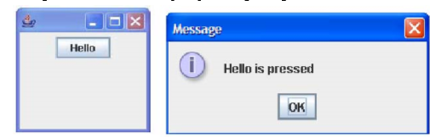
Event Handling Example:

Slide 12
Lets Code!

Slide 13
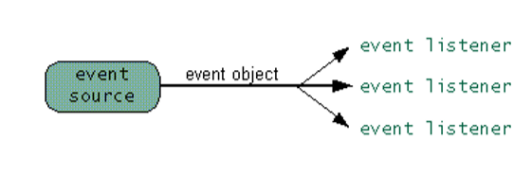
How Event Handling Participants interact Behind the Scenes?

Slide 14
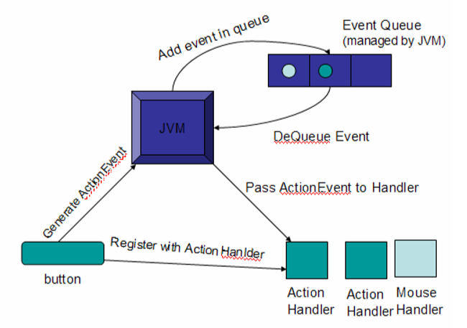

Slide 15
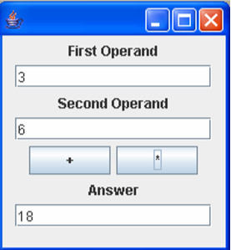
Calculator:

Slide 16
Lets Code!

Slide 17
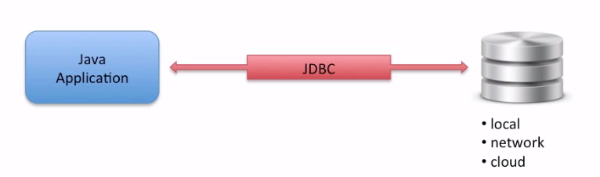
JDBC
Allows java applications to connect to a relational database.

Slide 18
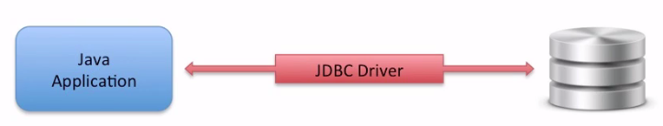
JDBC Architecture
JDBC Driver:
Provides connection to a database.
JDBC Driver Implementation:
Provided by database vendor.

Slide 19
JDBC API
JDBC API is defined in the following packages.
Java.sql
Key Classes:
Java.sql.DriverManager
Java.sql.Connection
Java.sql.Statement
Java.sql.ResultSet

Slide 20
Development Process
Get a connection to database
Create a Statement object
Execute SQL query
Process Result Set
Close Connection

Slide 21
Lets Code!

Slide 22
SOLID Principle
Single Responsibility Principle
Open Close Principle
Liskov Substitution Principle
Interface Segregation Principle
Dependency Inversion Principle

Slide 23
Single Responsibility principle

Slide 24
Single Responsibility principle
Single responsibility means that your class (any entity for that matter, including a method in a class, or a function in structured programming) should only do one thing.
A class should have only one reason to change.
Related to Coupling & Cohesion.

Slide 25
Single Responsibility principle
What a class does?
The more a class does, the more likely it will change.
The more a class changes, the more likely we will introduced bugs.
One of the simples principle but one of the most difficult to get right.

Slide 26
SRP example
Class Post{
void CreatePost (Database db, string postMessage) {
try{
db.Add(postMessage);
}
catch (Exception ex)
{
db.LogError(“An error occurred:”, ex.ToString());
File.WriteAllText(“\LocalErrors.txt”, ex.ToString());
}
}
}

Slide 27
Solution
Class Post{
Private ErrorLogger errorlLogger = new ErrorLogger();
void CreatePost (Database db, string postMessage) {
try{
db.Add(postMessage);
}
catch (Exception ex)
{
errorLogger.log(ex.ToString());
}
}
}
Class ErrorLogger {
void log(string error)
{
db.LogError(“An error occurred:”, error);
File.WriteAllText(“\LocalErrors.txt”, error);
}
}

Slide 28
Open close design principle

Slide 29
Open close design principle
“Software entities like classes, modules and functions should be open for extension but closed for modifications”
Bertrand Meyer

Slide 30
Open close design principle
The Open Close Principle states that the design and writing of the code should be done in a way that new functionality should be added with minimum changes in the existing code.
The design should be done in a way to allow the adding of new functionality as new classes, keeping as much as possible existing code unchanged.

Slide 31
Open close design principle
Open-closed principle have two primary attributes:
I. They are “Open For Extension”
This means that the behavior of the module can be extended. That we can make the module behave in new and different ways as the requirements of the application change, or to meet the needs of new applications.
II. They are “Closed for Modification”
No one is allowed to make changes in source code.

Slide 32
Open close design principle
The Open/Closed principle can be applied in be applied in object oriented paradigms with the help of inheritance and polymorphism:

Slide 33
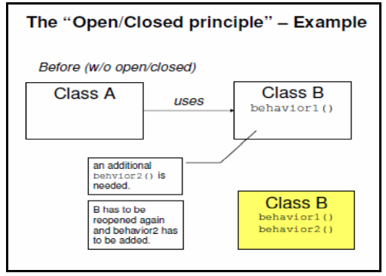
Open close design principle

Slide 34
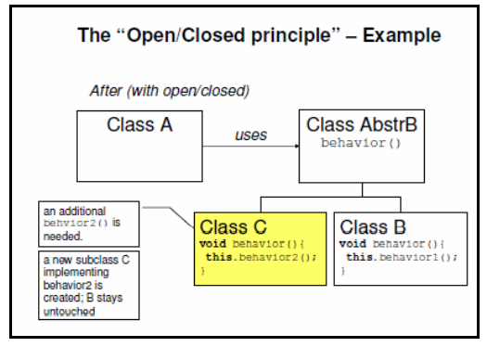
Open close design principle

Slide 35
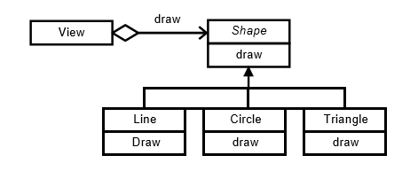
Example

Slide 36
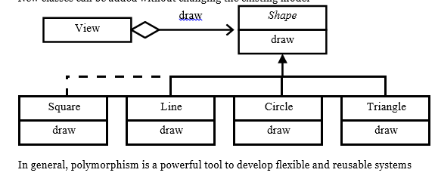
Example

Slide 37
OCP example
Class Post{
void CreatePost (Database db, string postMessage) {
If (postMessage.StartsWith(“#”))
{
db.AddAsTag(postMessage);
}
else
{
db.Add(postMessage);
}
}
}

Slide 38
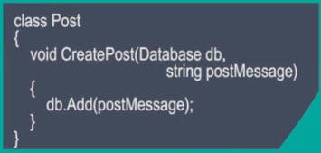
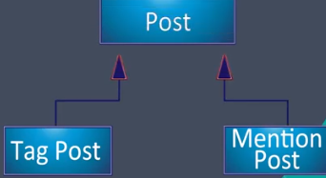
Solution

Slide 39
Liskov substitution principle

Slide 40
Liskov substitution principle
The principle defines that objects of a superclass shall be replaceable with objects of its subclasses without breaking the application. That requires the objects of your subclasses to behave in the same way as the objects of your superclass.
If substituting a superclass object with a subclass object changes the program behavior in unexpected ways, the LSP is violated.
The LSP is applicable when there’s a super-type sub-type inheritance relationship by either extending a class or implementing an interface.

Slide 41
LSP Importance
Liskov Substitution Principle actually teaches the exact meaning of inheritance.

Slide 42
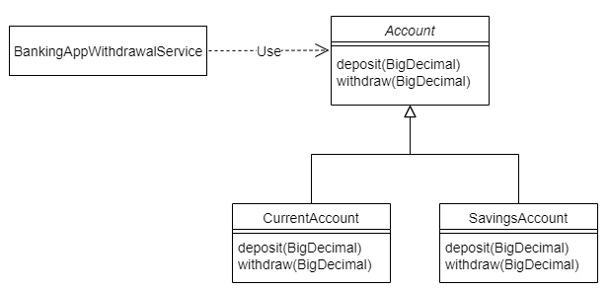
example

Slide 43
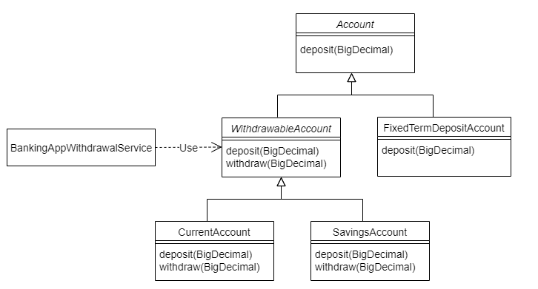
example

Slide 44
Interface segregation principle

Slide 45
Interface segregation principle
“Clients should not be forced to depend upon interfaces that they do not use.”

Slide 46
Interface segregation principle
If you have an abstract class or an interface, then the implementers should not be forced to implement parts that they don’t care about.
In programming, the ISP states that no client should be forced to depend on methods it does not use.

Slide 47
Interface segregation principle
Don’t add additional functionality to an existing interface by adding new methods.
Instead create a new interface and let your class implement multiple interfaces if needed.

Slide 48
Interface segregation principle
ISP deals with non cohesive interfaces and it reduces coupling in a system.

Slide 49
Isp (Example)
Interface iPost {
Void CreatPost();
Void ReadPost();
}
Interface iPostCreate {
Void CreatPost();
}
Interface iPostRead {
Void ReadPost();
}
Violation of ISP

Slide 50
Isp (Example)
Interface ISmartDevice{
void Print();
void Fax();
void Scan();
}
Violation of ISP
class AllinOnePrinter implements ISmartDevice{
public void Print() {
}
public void Fax() {
}
public void Scan() {
}
}

Slide 51
ISP Example
class EconomicPrinter implements Iprinter{
public void Print() {
}
public void Fax() {
throw new NotSupportedException();
}
public void Scan() {
throw new NotSupportedException();
}
}
Now suppose we need to handle a new device (EconomicPrinter class) that can only print. We're forced to implement the Whole interface.

Slide 52
Solution
interface Iprinter {
void Print();
}
interface Ifax {
void Fax();
}
interface Iscanner{
void Scan();
}
class EconomicPrinter implements ISmartDevice{
public void Print() {
}
}

Slide 53
Solution
class EconomicPrinter implements Iprinter, Ifax, Iscanner{
public void Print() {
}
public void Fax() {
}
public void Scan() {
}
}

Slide 54
ISP
The ISP guides us to create many small interfaces with coherent functionalities instead of a few big interfaces with lots of different methods.
When we apply the ISP, class and their dependencies communicate using focused interfaces, minimizing dependencies.
Smaller interfaces are easier to implement, improving flexibility and the possibility of reuse.

Slide 55
Dependency Inversion Principle

Slide 56
Dependency inversion principle
High Level Modules should not depend on low level modules. Both should depend on abstractions.
Abstractions should not depend upon details. Details should depend upon abstractions.

Slide 57
Dependency inversion principle
In programming., the dependency inversion principle is a way to decouple software modules.
OCP, LSP, and even SRP lead to the dependency inversion principle.

Slide 58
Dependency injection
Dependency Injection
Injecting any dependencies of a class through a class constructor as an input parameter.
Injection basically converts composition to association.
Strong coupling to weak coupling.

Slide 59
DIP (Example)
Class Post{
Private ErrorLogger errorlLogger = new ErrorLogger();
void CreatePost (Database db, string postMessage) {
try{
db.Add(postMessage);
}
catch (Exception ex)
{
errorLogger.log(ex.ToString());
}
}
}
Dependency
Class ErrorLogger {
void log(string error)
{
db.LogError(“An error occurred:”, error);
File.WriteAllText(“\LocalErrors.txt”, error);
}
}

Slide 60
Solution
Class Post{
Private Logger _logger;
Public Post (Logger injectedLogger){
logger = injectedLogger;
}
void CreatePost (Database db, string postMessage) {
{
…..
…..
}
}
Dependency Injection

Slide 61
HAVE A GOOD DAY!

